Slide 1
Employee Data Analysis using Excel
STUDENT NAME: DHANA LAKSHMI.V
REGISTER NO: 312200729, 115
DEPARTMENT: III B.COM, COMMERCE
COLLEGE: PACHAIYAPPAS COLLEGE FOR MENS, KANCHIPURAM.

Slide 2
PROJECT TITLE
Employee Performance Analysis using Excel

Slide 3


AGENDA
Problem Statement
Project Overview
End Users
Our Solution and Proposition
Dataset Description
Modelling Approach
Results and Discussion
Conclusion
3/21/2024 Annual Review

Slide 4

PROBLEM STATEMENT
The need of an performance analysis is increment of an
Employee basis on their performance, which employee works
Effectively in that organization, low performed employees to
Motivate and trained to the experienced faculties and Promotion
Given to the high performed employees. These are the usefulness
of Employee performance analysis.

Slide 5

PROJECT OVERVIEW
This project conveys Employee performance analysis,
Which employee to perform very well, as well as poor in
that particular organization to department wise and to identify
the trends and patterns of different categories of an employees.

Slide 6
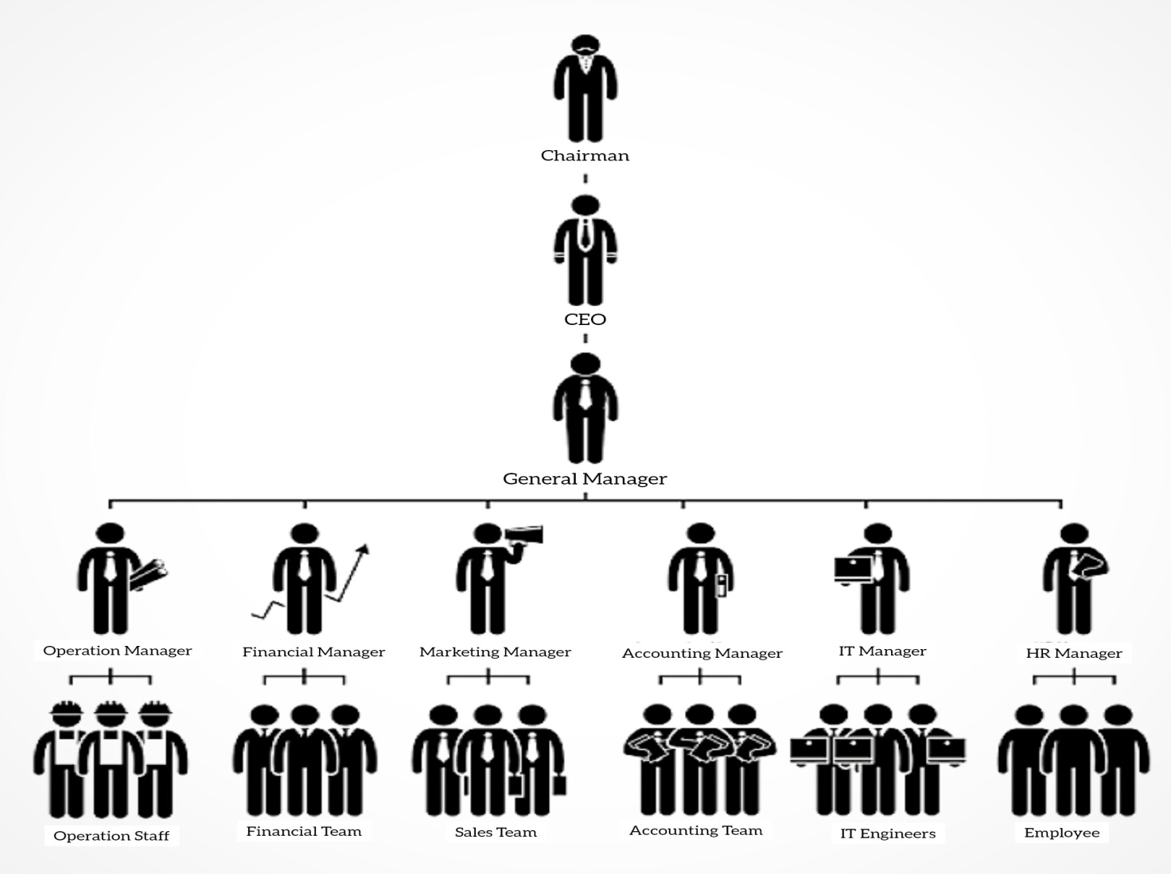

WHO ARE THE END USERS?

Slide 7

OUR SOLUTION AND ITS VALUE PROPOSITION
Conditional formatting – Shade Missing terms
Filter – Remove blanks
Formula – Calculate performance(=IFS)
Pivot – Summary
Graph – Representing date analysis

Slide 8
Dataset Description
Employee dataset = Kaggle platform
26 features are there in this dataset
I choose to consider only 8 features

Slide 9

THE "WOW" IN OUR SOLUTION
Level of performance =IFS formula
3/21/2024 Annual Review
9

Slide 10
MODELLING
Data collection
Download employee dataset in kaggle platform
Then insert in this dataset to excel
Feature collection
Identify the data like employee id, firstname, lastname, business unit,
Gender code, performance
Data cleaning
Identify the missing values
Filter out the missing values
Performance level
Identify the employee performance using the IFS formula
Summary
Using pivot table to filtering the features
Visualization
Insert the column graph
To visualize the employee performances
10

Slide 11
RESULTS
Employee Performance Analysis
11

Slide 12
conclusion
This project conveys, effectively about the performance of an employee
for the different trends and categories of an employees Very high, High,
Medium, Low Performances for an department wise as well as Gender wise.
The organization can easily analysis the capability of an employee for
the help of employee performance analysis….

